Slide 1


Landing on the Moon via Deep Deterministic Policy Gradients
Aerospace Engineering
AE 598 Reinforcement Learning Final Project
Pallavi Ravada
4/25/23

Slide 2

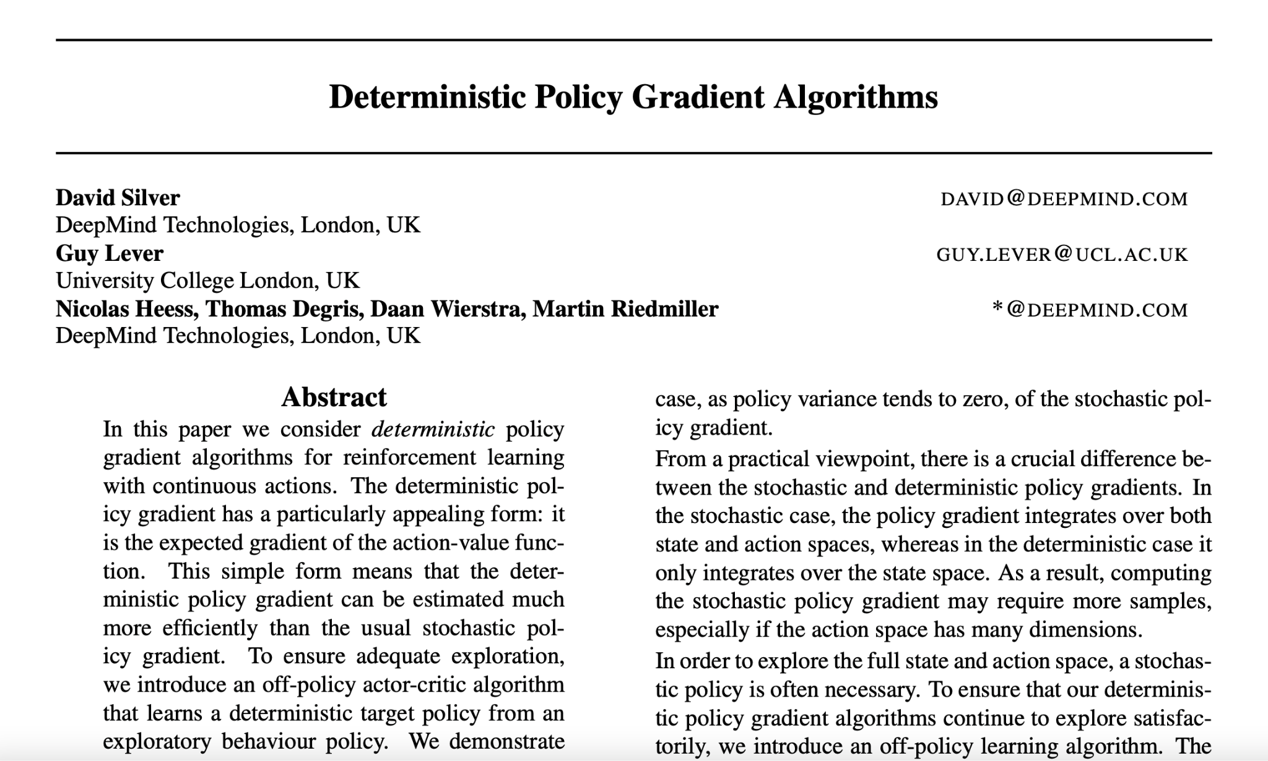
The Paper
AEROSPACE ENGINEERING
GRAINGER ENGINEERING

Slide 3
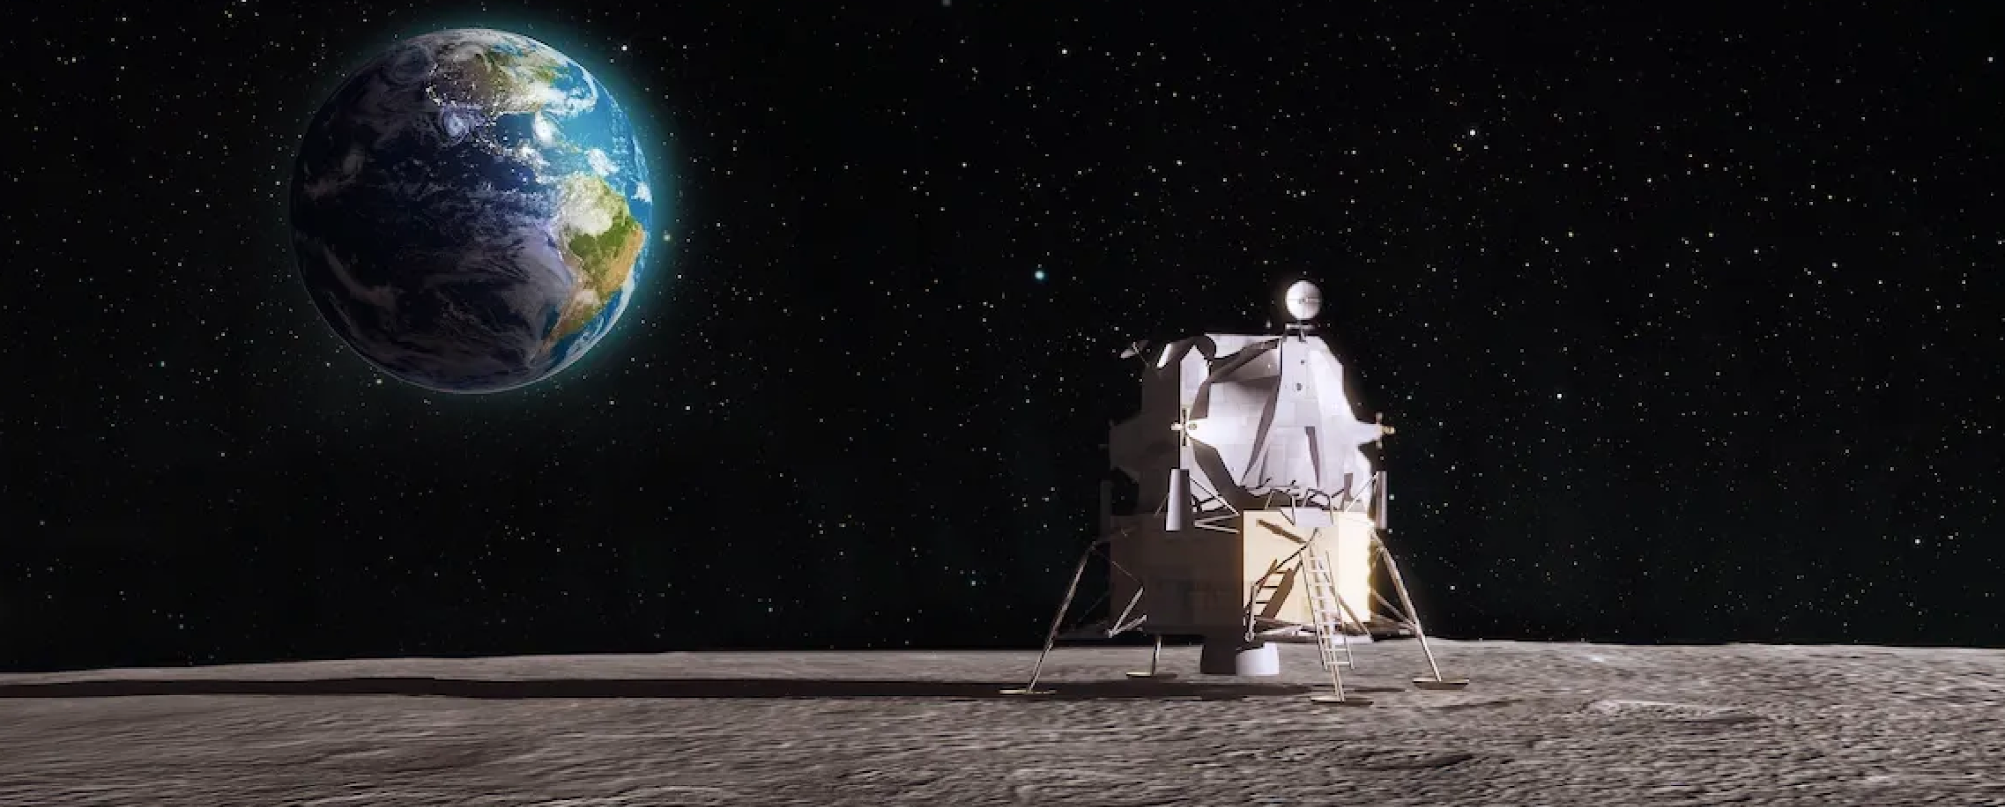
Motivation
Want to simulate human like-performance using reinforcement learning to successfully land a lunar lander
Demonstrates autonomous capabilities for lunar landings
DDPG for the lunar lander OpenAIGym environment is implemented
Continuous action and state space
After training DDPG on the lunar lander environment the agent is able to land on the surface of the moon successfully in multiple different environments
Image by AlphaCoders
AEROSPACE ENGINEERING
GRAINGER ENGINEERING

Slide 4
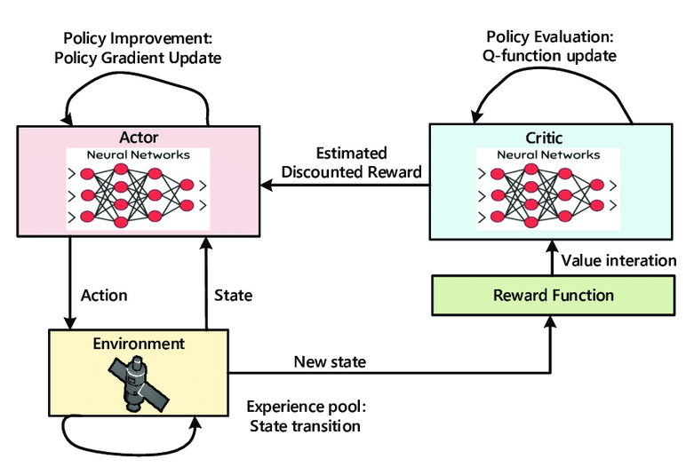
Introduction
What is DDPG?
Can be thought of as deep Q-learning (DQN) for continuous action spaces
Concurrently learns a Q-function and a policy
Off-policy + Bellman equation to learn Q-function => Q-function to learn policy
Actor-Critic technique
Used in continuous action setting and is an improvement over the vanilla Actor-Critic implementation
Image by Yixin Huang
AEROSPACE ENGINEERING
GRAINGER ENGINEERING

Slide 5
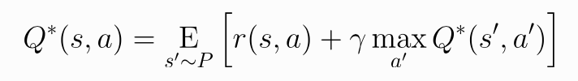
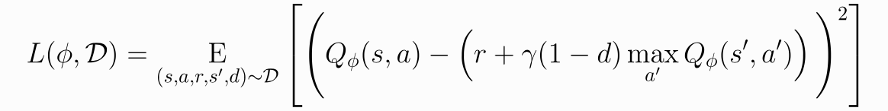


Method & Key Equations: Q-learning
Learning a Q-Function
Bellman Equation for optimal action-value function Q*(s,a)
Starting point for learning an approximator for Q*(s,a)
Assume approximator is a neural network Q_phi(s,a) with phi parameters
Mean squared Bellman error (MSBE) function which calculates how close Q_phi is to Q*
Want to minimize MSBE
Replay Buffer
Standard for training a deep neural network to approximate Q* to ensure algorithm stability
The set of previous experiences must be large enough to house a wide range of experiences
Too recent experience => overfitting | Too much experience => slow learning
Target Networks
Make use of target networks as want Q-function to be more similar to target to minimize MSBE
Using a set of parameters similar to phi with a time delay allows the target network functionality to work
Target network updated once per main network update using polyak averaging
AEROSPACE ENGINEERING
GRAINGER ENGINEERING

Slide 6
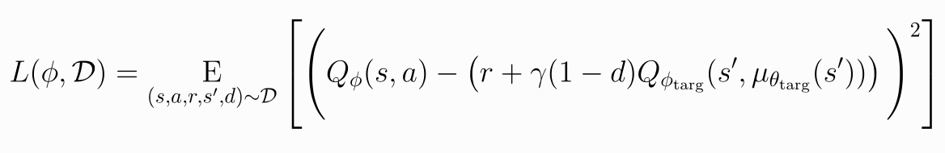
DDPG Detail
Computing Max Over Continuous Actions in the Target
Difficult to compute maximum over continuous action spaces because action space cannot be exhaustively evaluated
Calculating the max of Q* using normal algorithms would be very costly
DDPG gets around this by using the target policy neural network to compute the action that maximizes the Q-function for the target
Target policy network determined in the same manner as the target Q-function
Putting it all Together
Q-learning in DDPG accomplished via MSBE loss minimization with stochastic gradient descent
AEROSPACE ENGINEERING
GRAINGER ENGINEERING

Slide 7

Method & Key Equations: Policy Gradient
Learning a Policy Gradient
Want to learn a deterministic policy that determines the action that maximizes the Q-function
Assume Q-function is differentiable because action space is continuous and directly solve
Exploration vs. Exploitation
DDPG trains a policy in an off-policy manner that is deterministic
Due to the deterministic nature of the policy the agent would not be able to accomplish significant learning
Noise is added to the actions at training time to make DDPG explore and perform better
OU (Ornstein-Uhlenbeck) Noise was used in the paper implementation but recent results suggest that mean-zero Gaussian noise works just as well
OU Noise = temporarily correlated noise that is used to explore physical environments that have momentum
AEROSPACE ENGINEERING
GRAINGER ENGINEERING

Slide 8
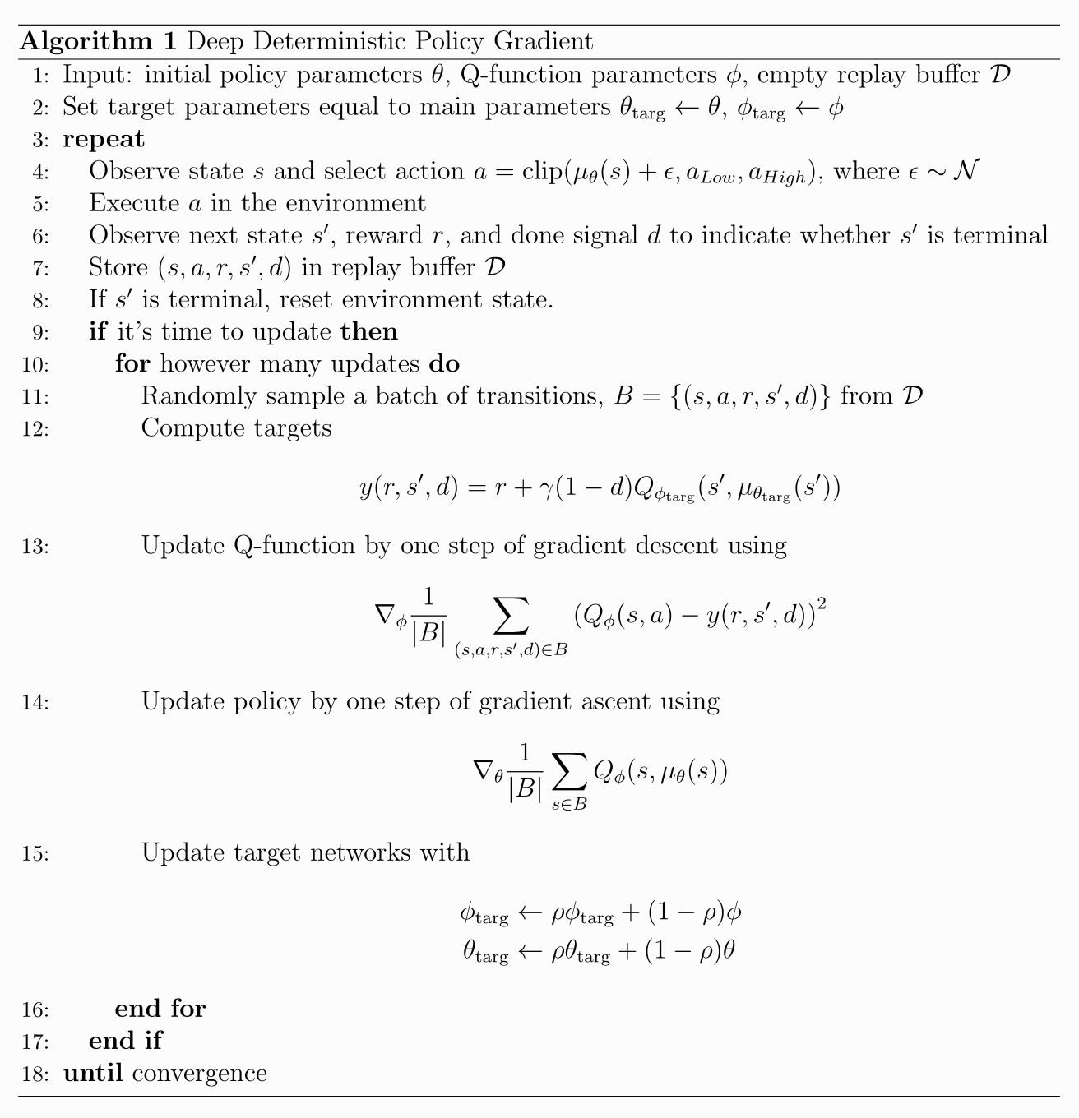
Pseudocode
AEROSPACE ENGINEERING
GRAINGER ENGINEERING

Slide 9
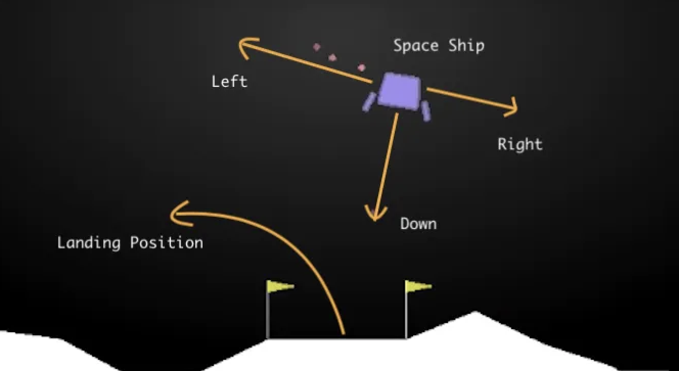
About Lunar Lander
The Environment & Model
One spaceship with unlimited fuel
Goal is to land the spaceship smoothly between the two goal flags
Coordinates (0,0)
Ship has three throttles for control
Down
Left
Right
OpenAIGym has both the discrete and continuous models
Image by medium.com
AEROSPACE ENGINEERING
GRAINGER ENGINEERING

Slide 10
Results: Lunar Landings
Training
Trained on one fixed environment
First lander does not know how to use thrusters
Then agent slowly improves control over thrusters
Finally agent is able to land in between the goal flags without crashing
Evaluation
Evaluated across 5 other randomly generated environments
Success rate ⅘ => 80%
One example run is shown below
AEROSPACE ENGINEERING
GRAINGER ENGINEERING

Slide 11
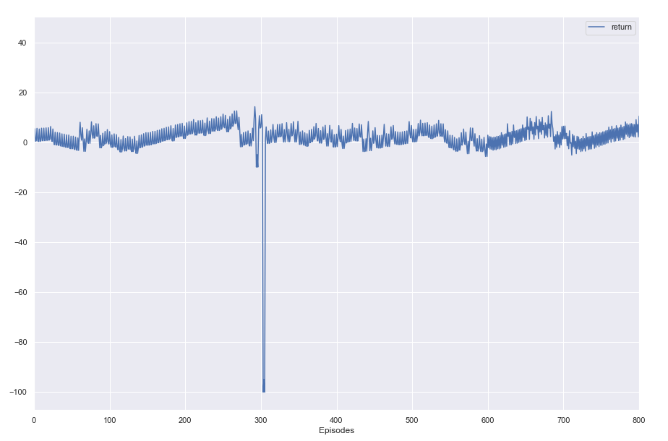
Results: Learning Curve
AEROSPACE ENGINEERING
GRAINGER ENGINEERING

Slide 12
Conclusions
Remarks
DDPG used to train an agent to solve the OpenAIGym continuous lunar lander environment
DDPG used because of its ability to handle continuous action spaces
With favorable initial conditions the learned agent was able to land in new lunar lander environments
Failures did occur with the trained agent
Unable to master all environments with the current amount of training, but close
DDPG efficient algorithm for solving the lunar lander environment most of the time
There is always room for improvement!
Limitations
Requires many training episodes to stabilize and produce a generalized policy
Heavily dependent on hyperparameters, requires a lot of fine tuning
Future Work
More training and run more test cases, see if success rate can be increased
Further hyperparameter tuning
AEROSPACE ENGINEERING
GRAINGER ENGINEERING

Slide 13
Thank You
Questions?
AEROSPACE ENGINEERING
GRAINGER ENGINEERING

Slide 14


